Slide 1
Evaluating Flight Price Changes
Team 11
Hanze Zhang (hanzez), Yi-Hsueh Yang (yihsuehy)

Slide 2
Key Findings
It’s the cheapest to search on Sundays and Mondays and fly on Tuesdays and Wednesdays.
Search and buy tickets in advance, avoid purchasing before going back to school.
The tickets price climbs to its peak at June and starts to fall linearly afterwards, price for vacation on July and August should be better than you thought
If you are going to New York City:
From most cities, flying to LaGuardia Airport should cost you less than flying to JFK and EWR.
If you are going to San Francisco:
For direct flights, you might only be able to fly to SFO.
For transfer flights, flying to SFO is a better choice as on average its price is lower than flying to OAK.
Notes:
Time
Strategy
Choose the right airport

Slide 3
Motivation and Context
People travels a lot nowadays, and it is quite often that we end up paying more than the person sitting next to us which could be pretty annoying and costly. Since flight price is determined on a dynamic basis, it is almost impossible to get to know the fluctuation of the ticket price. Therefore, we are thinking of using data visualization to plot out precious information to get to know the pattern of it and to find out the influencing factors behind it.

Slide 4
Datasets
31.09 GB
Search date: 4/16 - 10/5
Flight date: 4/17 - 11/19
The dataset is a single .csv file containing every purchasable ticket found on Expedia between 2022-04-16 and 2022-10-05, to/from the following airports: ATL, DFW, DEN, ORD, LAX, CLT, MIA, JFK, EWR, SFO, DTW, BOS, PHL, LGA, IAD, OAK.
Following analysis is performed on flight data from April to May, which is separated from the original dataset for better analysis.
# of rows: 5,932,740, each row represents a search
# of columns: 15
Link:
Kaggle: https://www.kaggle.com/datasets/dilwong/flightprices
Github: https://github.com/dilwong/FlightPrices

Slide 5
Exploratory Analysis
All data
Daily Average data
Daily Average Search data
count | 8.213875e+07
mean | 3.403868e+02
std | 1.960295e+02
min | 1.959000e+01
25% | 1.971000e+02
50% | 3.052000e+02
75% | 4.520900e+02
max | 8.260610e+03
count | 217
mean | 343.729418
std | 59.454325
min | 212.702475
25% | 300.069158
50% | 342.401554
75% | 384.156641
max | 524.246711
count | 171
mean | 344.018742
std | 39.902537
min | 292.126969
25% | 307.639980
50% | 336.526566
75% | 382.110489
max | 421.235954

Slide 6
Key Questions
What is the average price difference for flights departing on different dates?
What is the average price difference for flights departing on different days in a week?
Is there a difference in price for flights from the same origin but flying to different airports around the same city?
Will the number of seat remaining influence the ticket price?

Slide 7
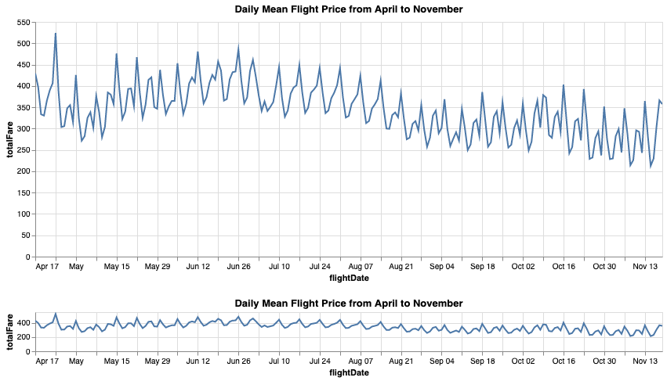
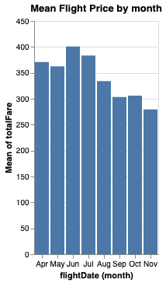
Q1. What is the price difference for flights departing on different dates?

Slide 8
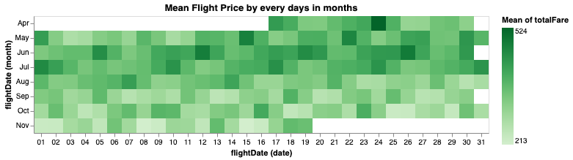
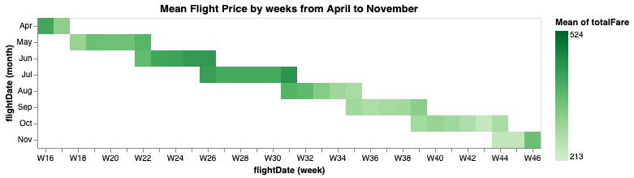
Q1. What is the price difference for flights departing on different dates?
April 24th $ 524.25
November 15th $ 212.70

Slide 9
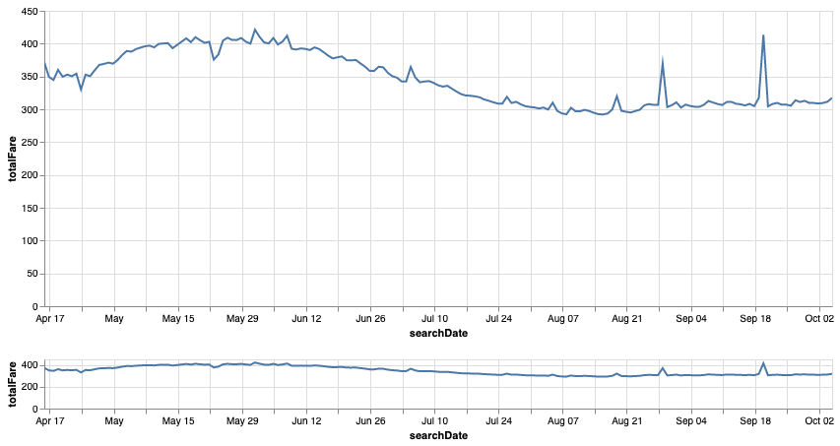
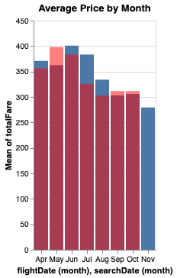
Q1. What is the price difference for flights departing on different dates?
Average Searching Flight Price Throughout the time - Questions 1
Notes:
the peak for searching price is May, while it is June for the actual flight price. So, it could be a strategy to wait a while before purchasing flights that fly in June.

Slide 10
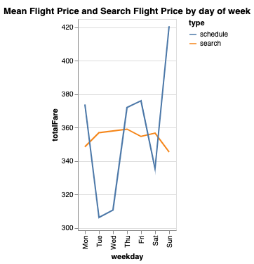
Q2. Average Flight Price among weekdays
Search on Sundays & Mondays
Fly on Tuesdays & Wednesdays

Slide 11
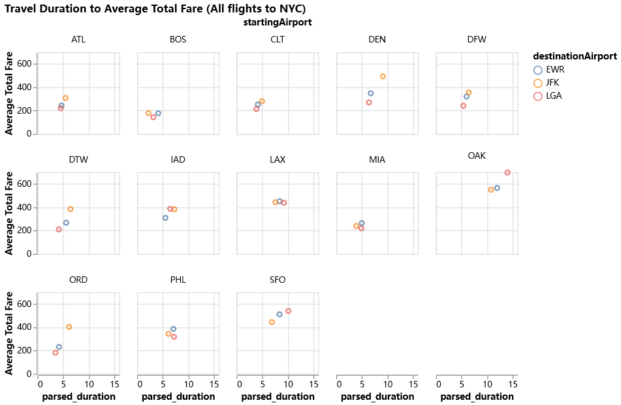
Q3. Difference in price for flights from the same origin but flying to different airports in the same city?
Three airports near NYC:
Newark Liberty International Airport (EWR)
John F. Kennedy International Airport (JFK)
LaGuardia Airport (LGA)

Slide 12
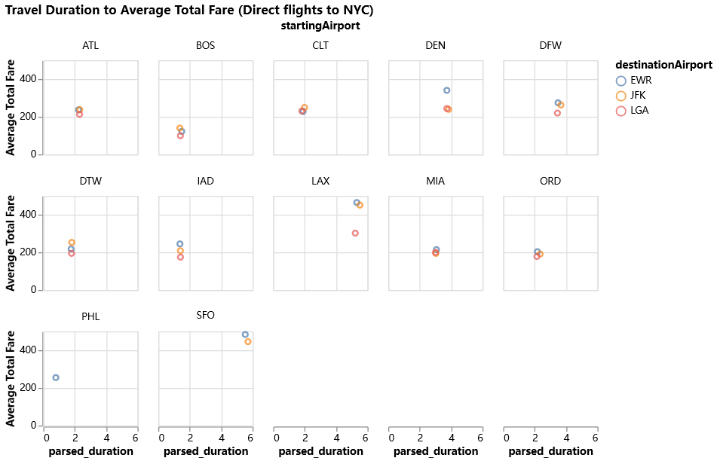
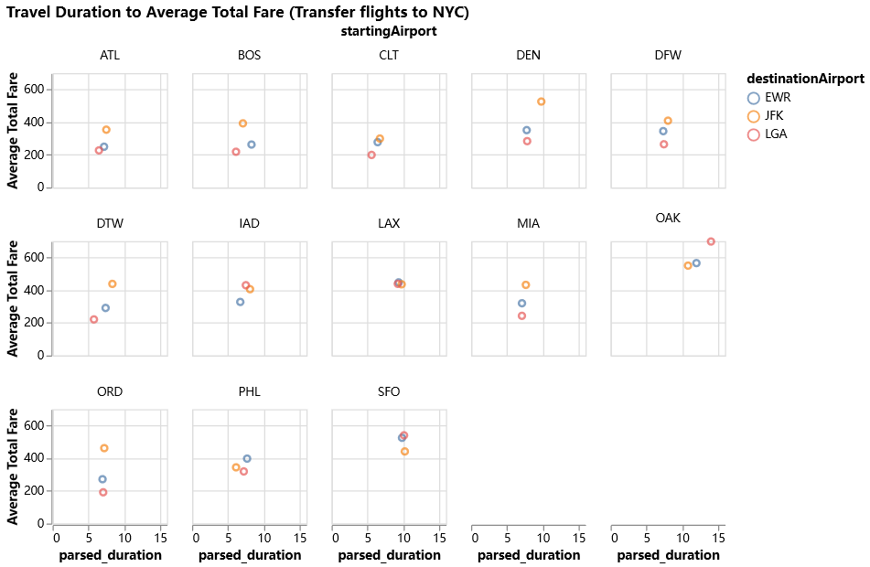
Q3. Difference in price for flights from the same origin but flying to different airports in the same city?
Key insights:
On average, from most departure cities, flying to LGA costs lower than flying to other airports for both direct and transfer flights.

Slide 13
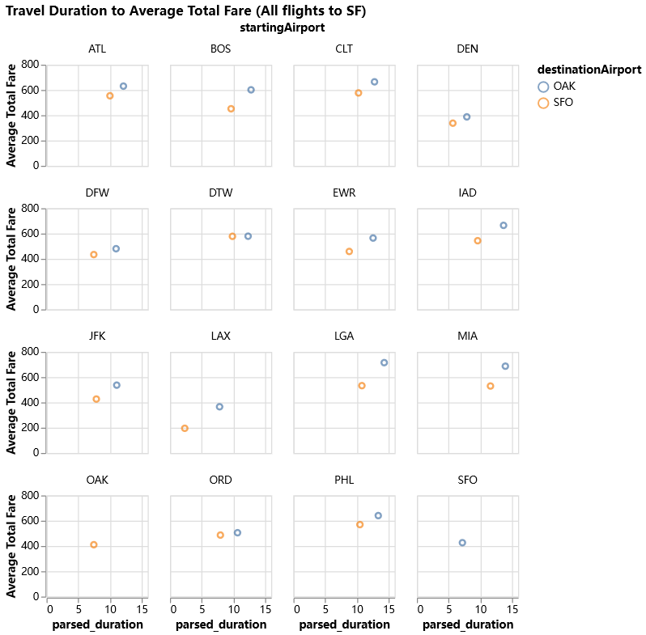
Q3. Difference in price for flights from the same origin but flying to different airports in the same city?
Two airports near San Francisco:
Oakland International Airport (OAK)
San Francisco International Airport (SFO)

Slide 14
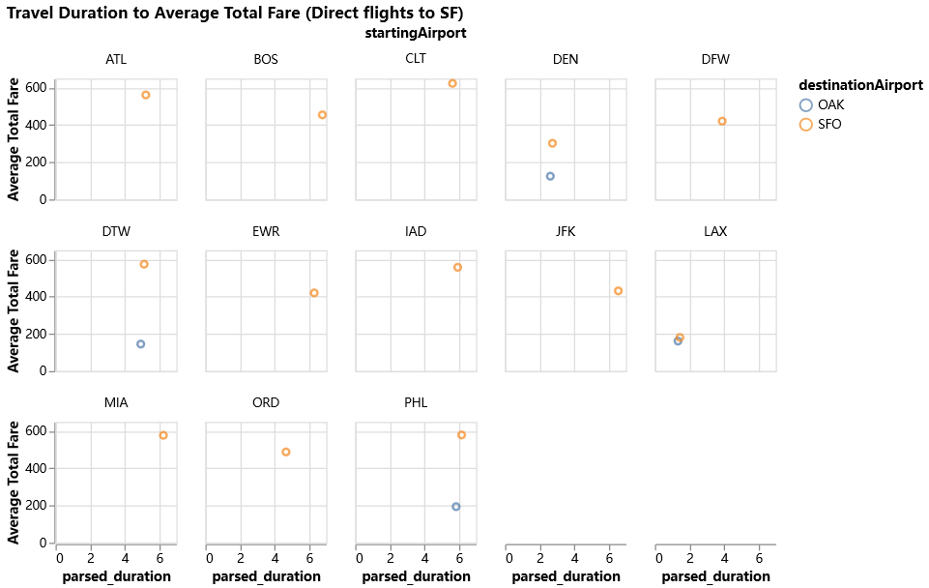
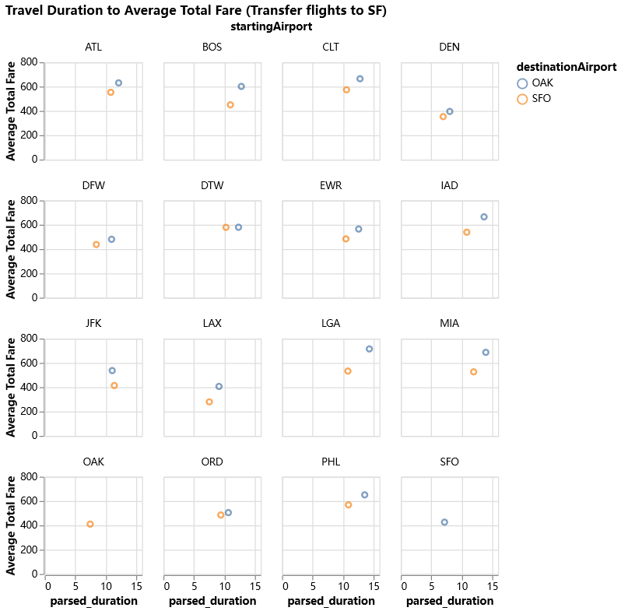
Q3. Difference in price for flights from the same origin but flying to different airports in the same city?
Key insights:
Not too many airports have direct flights flying to OAK.
Among those that have direct flight to OAK, flying to OAK costs much lower than flying to SFO.
For transfer flights, SFO is a better option as it has lower average total fare than OAK.

Slide 15
Limitations
No flight number → hard to find insight related to individual flight
One possible solution is to perform groupby on columns that can help identify unique flights, such as departure time, airlines, departure and arrival cities, times, etc.
However, after the groupby we still have 2,094,702 unique groups.
Original data is too big → so the only feasible way is to divide the data into piece for analysis, gain limited some insights

Slide 16
